Slide 1
Introduction to SwiftUI Project in Xcode
iCodeWave Community

Slide 2
Things You Need to Know
We use Xcode as Integrated Development Environment to develop Apple platform apps
Since 1990s most developers used Objective-C as language to develop apps
Then… at 2014, Apple release Swift as language and replace to Objective-C to develop apps
Later at 2019, Apple release SwiftUI as another framework to build Apple apps and simplified some code of UIKit
SwiftUI introduce the new way of code and UI in simplified way
iCodeWave Community

Slide 3
Advantages of Using SwiftUI
Simplified code
Declarative programming
Simplified when designing UI with code
Time-efficient code
Live previews perform like hot reload
View based design pattern (UIKit is MVC)
Ability to build entire ecosystem Apple app, one code-base for all Apple platforms (iPhone, iPad, Mac, Apple Watch, Apple TV 4K, and Vision Pro)
iCodeWave Community

Slide 4
Disadvantages of Using SwiftUI
Only use standardised UI from Human Interface Guidelines
More work to implement custom UI
Still need implement from parent’s framework if necessary (iOS & iPadOS: UIKit, macOS: AppKit, tvOS: TVKit, watchOS: WatchKit)
Deploy higher version of iOS, iPadOS, macOS, tvOS, watchOS, and visionOS
Still have common bug until today
iCodeWave Community

Slide 5
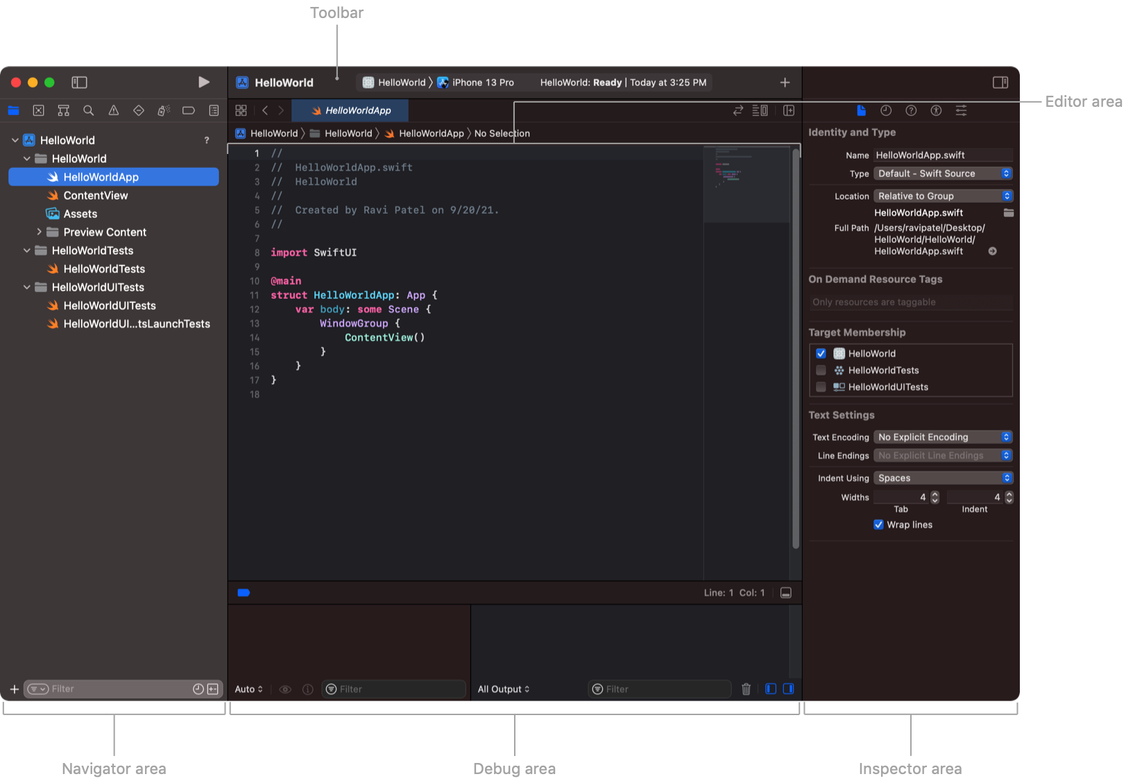
Xcode Interface along with SwiftUI Project
iCodeWave Community

Slide 6
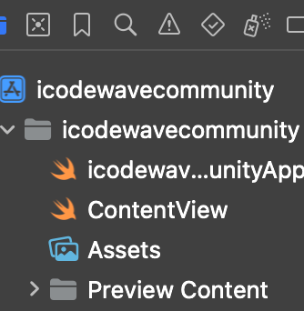
Xcode + SwiftUI
The file types
.xcodeproj is the project settings of an apps
…App.Swift is where your app launch at where View
.swift contains your code and UI
.xcassets contains your assets such as images and color sets
Preview Content containt previewing assets that won’t include in your bundle app (not compiled when distribute to App Store)
iCodeWave Community

Slide 7
Thanks For Your Attendance Today!
iCodeWave Community

